Slide 1
Hybrid Cryptography
Team Details
Vishwas(20EG105411)
Abhinav(20EG105426)
Chaitanya(20EG105437)
Project Supervisor
B Ravinder Reddy
Assistant Professor

Slide 2
Introduction
Cryptography and Information Security: Hybrid of two algorithms ECC and diffie-hellman.
A hybrid algorithm that combines Elliptic Curve Cryptography (ECC) and the Diffie-Hellman key exchange can provide a secure way of key generation and exchanging process.
The ECC key exchange provides secrecy and protection against quantum attacks, while Diffie-Hellman offers a well-established method for secure key exchange.

Slide 3
Literature
SI No | Author(s) | Method | Advantages | Disadvantages
01. | Sachin rana , satarupa biswas and Anushika pansari | -ECC algorihm -Diffie hellman | Reduced Encryption and decryption time | Large key size
02 | Dr.Vivek Kapoor and Rahul Yadav | -RSA algorithm -DES algorithm -SHA128 | 128-Bit Key Strength. Secure Data Transmission. Data Integrity | Performance Impact and need high computational power.
03 | Arpit Agarwal and Gunjan Patnakar | -RSA algorithm -Diffie-hellman -SHA1 | Scalability. Highly Efficienct. Secure key sharing. | Require technical expertise and users need to understand how to use encryption properly.

Slide 4
04 | Y Alkady, M. I. Habib and R. Y. Rizk | -RSA algorithm -ECC algorithm -MD5 | better performance in terms of computation time and the size of cipher text. | High complexity , might need more resources.
05 | Prakash Kuppuswamy and Sayeed Q.Y. Al-khalidi | -Symmetric Key Algorithm - Linear Block Cipher Algorithm. | Better Performance. Enhanced Security. Resistance to Attacks. | Increased implementation challenges. Security of Key Exchange. Potential vulnerabilities

Slide 5
Problem Statement
The combination of Diffie-Hellman acts a secure key transmission agent for the RSA and the RSA accounts for the security of message. However, this method has a very huge key length which effects the performance for the system.
Objective
To overcome this problem to ensure improved data security with reduced key size , we use hybrid algorithm of ECC with Diffie Hellman.
The parameters improved are:
encryption time
decryption time
key size

Slide 6
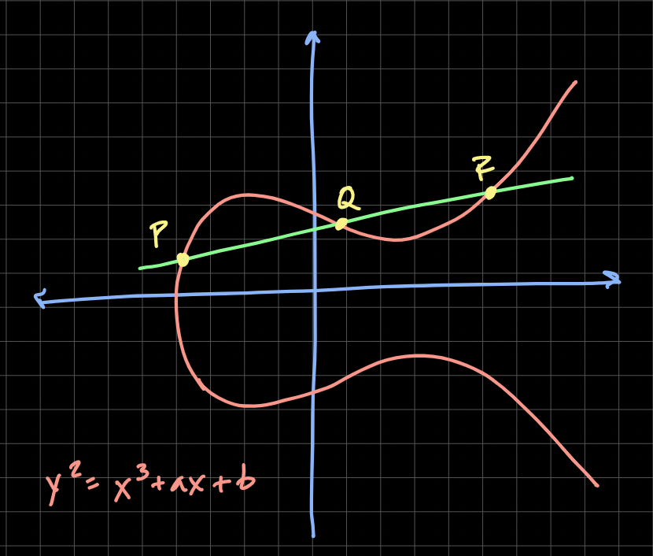
Proposed Method
ECC, an alternative technique to RSA, is a powerful cryptography approach. It generates security between key pairs for public key encryption by using the mathematics of elliptic curves.
It makes use of elliptic curves.
The curves are symmetric to x-axis.
A line is drawn at any random place on the curve , the points where the line touches are taken as public and private values

Slide 7
Proposed Method
Start
Generate ECC Key Pair (Alice)
Select ECC Parameters (Curve, Base Point)
Generate ECC Key Pair (Bob)
Alice and Bob exchange public keys
Alice computes Shared Secret Key
Bob computes Shared Secret Key
Shared Secret Key is now established
End

Slide 8
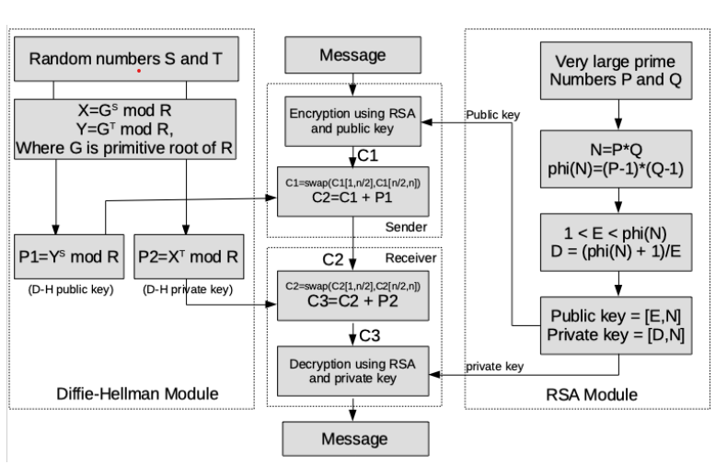
FlowChart

Slide 9
The ECDH (Elliptic Curve Diffie–Hellman Key Exchange) is anonymous key agreement scheme, which allows two parties, each having an elliptic-curve public–private key pair, to establish a shared secret over an insecure channel. ECDH is very similar to the classical DHKE (Diffie–Hellman Key Exchange) algorithm, but it uses ECC point multiplication instead of modular exponentiations. ECDH is based on the following property of EC points:
(a * G) * b = (b * G) * a
If we have two secret numbers a and b (two private keys, belonging to Alice and Bob) and an ECC elliptic curve with generator point G, we can exchange over an insecure channel the values (a * G) and (b * G) (the public keys of Alice and Bob) and then we can derive a shared secret: secret = (a * G) * b = (b * G) * a. Pretty simple. The above equation takes the following form:
alicePubKey * bobPrivKey = bobPubKey * alicePrivKey = secret

Slide 10
The ECDH algorithm (Elliptic Curve Diffie–Hellman Key Exchange) is trivial:
1.Alice generates a random ECC key pair: {alicePrivKey, alicePubKey = alicePrivKey * G}
2.Bob generates a random ECC key pair: {bobPrivKey, bobPubKey = bobPrivKey * G}
3.Alice and Bob exchange their public keys through the insecure channel (e.g. over Internet)
4.Alice calculates sharedKey = bobPubKey * alicePrivKey
5.Bob calculates sharedKey = alicePubKey * bobPrivKey
6.Now both Alice and Bob have the same sharedKey == bobPubKey * alicePrivKey == alicePubKey * bobPrivKey

Slide 11
Project status
Sl. No | List of Functions | Status
01 | Algorithm Building | Completed
02 | Preparing the flowchart | Completed
03 | Ecc value pair generation | In progress
04 | Public variables digest | In progress
05 | Key Generation using diffie-hellman | Not Yet Started
06 | Encryption of the plain text | Not Yet Started
07 | Decryption of the cipher text | Not Yet Started

Slide 12
References
Sachin rana , Satarupa biswas and Anushika pansari,"Hybrid Cryptography Algorithm For Secure And Low Cost Communication" , International Conference on Computer Science Engineering and Applications(2020)
Dr.Vivek Kapoor and Rahul Yadav, "A Hybrid cryptography technique for increasing network security", International Journal of Computer Applications (0975 – 8887)
Arpit Agarwal and Gunjan Patnakar, "Design of Hybrid Cryptography Algorithm for Secure Communication", International Research Journal of Engineering and Technology (IRJET)
Y Alkady, M. I. Habib and R. Y. Rizk, "A new security protocol using hybrid cryptography algorithms", 2013 9th International Computer Engineering Conference (ICENCO)
Prakash Kuppuswamy and Sayeed Q.Y. Al-khalidi, "Hybrid Encryption/Decryption Technique Using New Public Key and Symmetric Key Algorithm", MIS Review
Software Engineering Ninth edition by Ian Sommerville

